Slide 1

Cycling analytics for individuals with Type 1 Diabetes
A project in collaboration with Team Novo Nordisk and the Bern University Hospital
Eva van Weenen | May 12, 2021

Slide 2
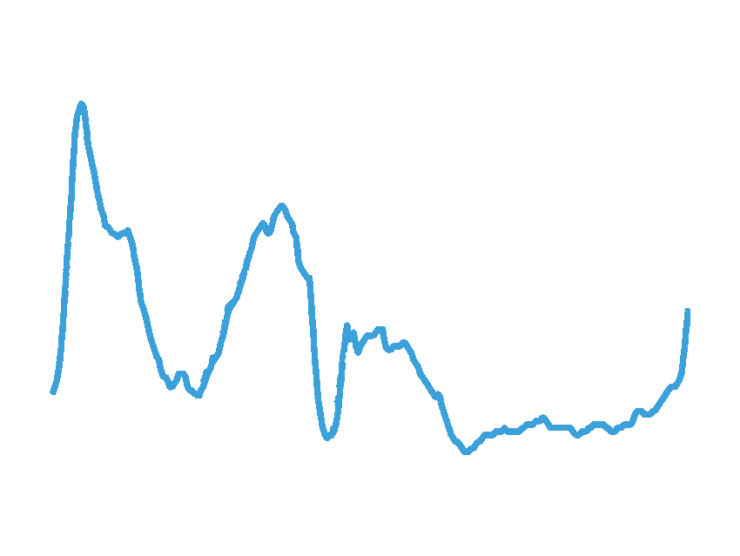

Background - Type 1 Diabetes
Hyperglycaemia
insulin
Blood glucose
Hypoglycaemia
Time
Notes:
In individuals with Type 1 Diabetes, the pancreas does not produce enough insulin to regulate blood sugar. It is therefore important for individuals with Type 1 Diabetes to keep their blood glucose within a target range. Otherwise they risk having either too high blood glucose levels (hyperglycaemia), with long-term effects of damage to the nerves, kidneys, bloodvessels and eyes. Or they risk having too low blood glucose levels (hypoglycaemia), which may lead to acute seizures, loss of consciousness, heart arrhythmia, coma or even death. This can be regulated with continuous glucose monitoring.

Slide 3
Background - Exercise and diabetes
Regular exercise is recommended for individuals with diabetes
Essential for health, fitness and longevity
Exercise with Type 1 Diabetes is challenging
There are many variables that can cause blood glucose to fluctuate significantly
For individuals engaging in professional endurance exercise, there is less information about the needs and about the real-time glycaemic response
Objective: Support professional cyclists with Type 1 Diabetes in glucose management during exercise
Notes:
Regular exercise is essential for individuals with both types of diabetes, for health, fitness and longetivity. For example, it can reduce risk factors for cardiovascular disease. In addition, exercise can improve blood glucose control and insulin sensitivity. However, exercise for individuals with Type 1 Diabetes is also challenging. There are many factors that can influence blood glucose during exercise, which must be balanced with insulin and the right amount of carbohydrates. For medium-level intensity sports, glycaemic management has been well documented. However, for professional endurance sports, there is still a gap that needs to be bridged. For endurance exercise on a professional level, there is much less information about the needs of the individual, as well as the real-time glycaemic response. Our objective of this project is therefore to support professional sportsmen with Type 1 Diabetes in their glucose management during exercise. As this project is together with Team Novo Nordisk, we are analyzing the data of professional cyclists.

Slide 4

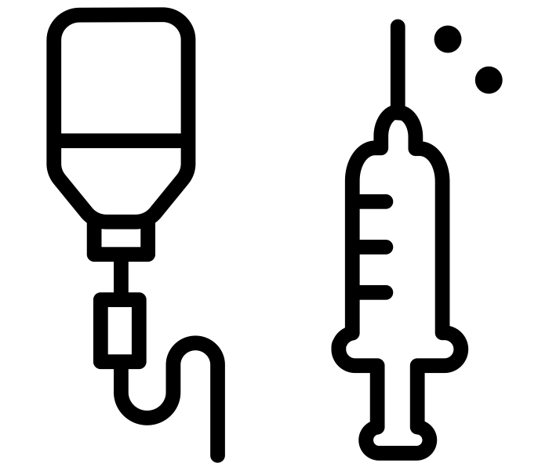
Data - Team Novo Nordisk
11 professional cyclists over the course of one training season (year)
Cycling
Glucose
Notes:
For this project we are analyzing the data of Team Novo Nordisk. This is a professional cycling team solely consisting of people with diabetes. They closely manage their diabetes while training and competing at a professional level. The data from Team Novo Nordisk consists of the cycling data and glucose data of 11 professional athletes over the course of one training season (year).

Slide 5

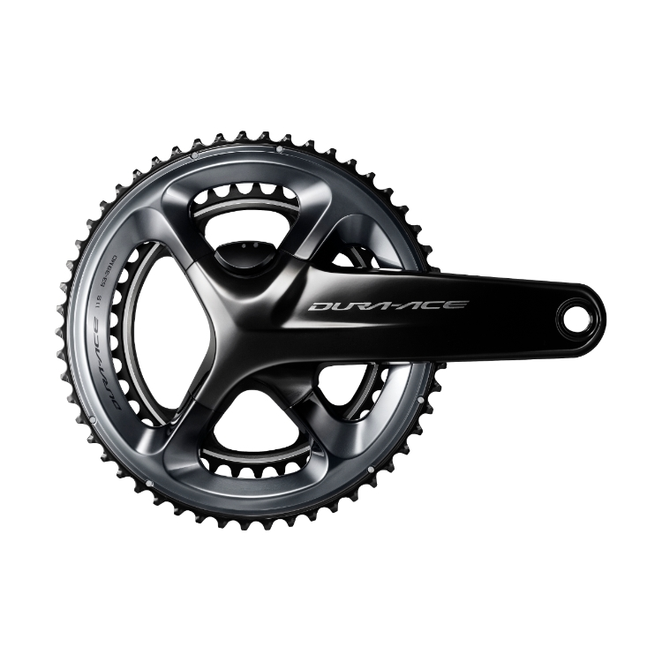
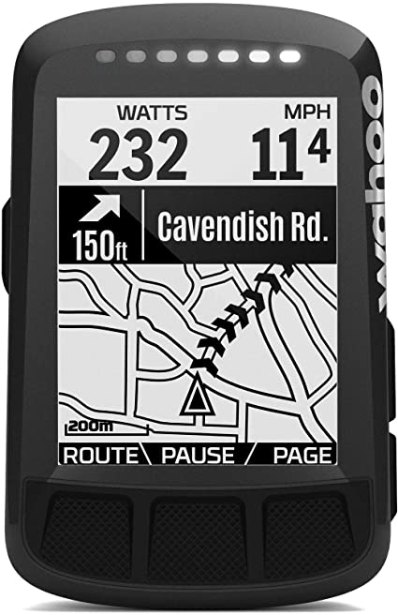
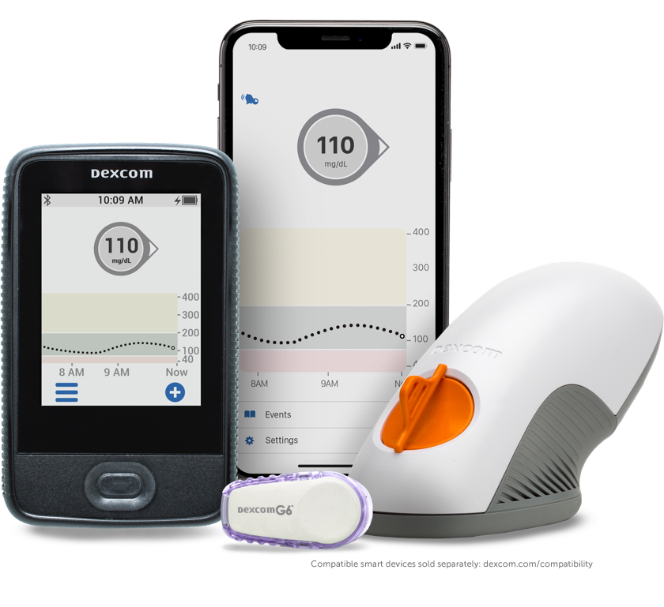
Data - Team Novo Nordisk
11 professional cyclists over the course of one training season (year)
Cycling
Glucose
heart rate power bike computer
CGM (dexcom)
Notes:
The data that we have during their training sessions consist of a heart-rate band, a power monitor (which can also distinguish between left and right), as well as a bike computer (giving insights into the location, speed, altitude, etc.). This data is at a 1 second interval during each training session. These athletes use the real-time continuous glucose monitoring system “dexcom”, which tracks glucose levels continuously at a 5 minute interval. Note that the glucose levels are measured in the interstitial fluid, which shows a 15 minute delay with respect to the blood.

Slide 6
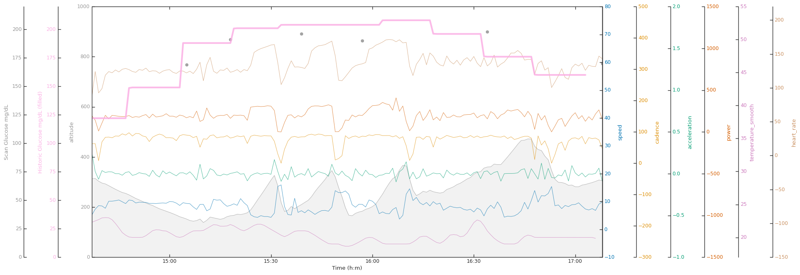
Data - Example of one training session
TODO: THIS IS A PLACEHOLDER, USE SIMILAR FIGURE WITH NEW DEXCOM DATA

Slide 7
Objective
Support professional cyclists with Type 1 Diabetes in glucose management during exercise
Insights in glucose levels before-, during- and after training sessions
Time spent in glucose levels hypo (L1 and L2), within range, and hyper (L1 and L2)
Association of training sessions with time spent in glucose levels
Correlation between variables such as power, altitude, training stress score, etc. from a training session with glucose
Predict future glucose levels based on current and past glucose and current and past exercise
More accurate prediction of future glucose + insights in glycaemic response during exercise
Notes:
The data that we have is quite unique, as it is data of professional athletes with Type 1 Diabetes over the course of one year. Therefore there are various ways in which this data can be analyzed. (List enumeration) In this way we aim both to support the athletes in their glucose management, e.g. improve it, as well as generate potential insights in the glycaemic response during endurance exercise.

Slide 8
Questions?

